Slide 1
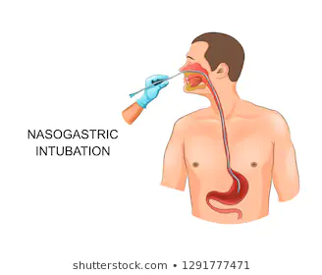
Adult Nursing(2nd Stage)
Nasogastric Tube
Lecture 3
By
Assistant. Lecturer. Khadija Mohammed Jassim
Fundamentals of Nursing Department
College of Nursing
University of Basrah
University of Basrah –College of Nursing – Fundamentals of Nursing Department

Slide 2
Nasogastric Tube
Gastrointestinal intubation deals with the inserting of a rubber or plastic tube into the stomach, duodenum or small intestine.
Types of tubes:
Short tubes: passed through the nose into the stomach.
Medium tubes: passed through the nose to the duodenum and jejunum , used for feeding.
Long tubes: passed through the nose , esophagus and stomach into the intestine , used for decompression of the intestines.
University of Basrah –College of Nursing– Fundamentals of Nursing Department
2

Slide 3
nasogastric tubes come in various size (8, 10, 12, 14, 16 and 18 Fr).
Indications for GI intubation:
To decompress the stomach and remove the gas and liquid.
To lavage the stomach and remove the ingested toxins.
To administer medications and feeds.
As part of the management of an obstruction.
As part of the management of hematemesis.
To aspirate gastric content for analysis.
University of Basrah –College of Nursing– Fundamentals of Nursing Department
3

Slide 4
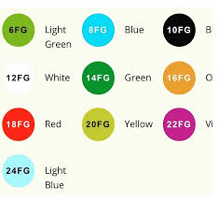
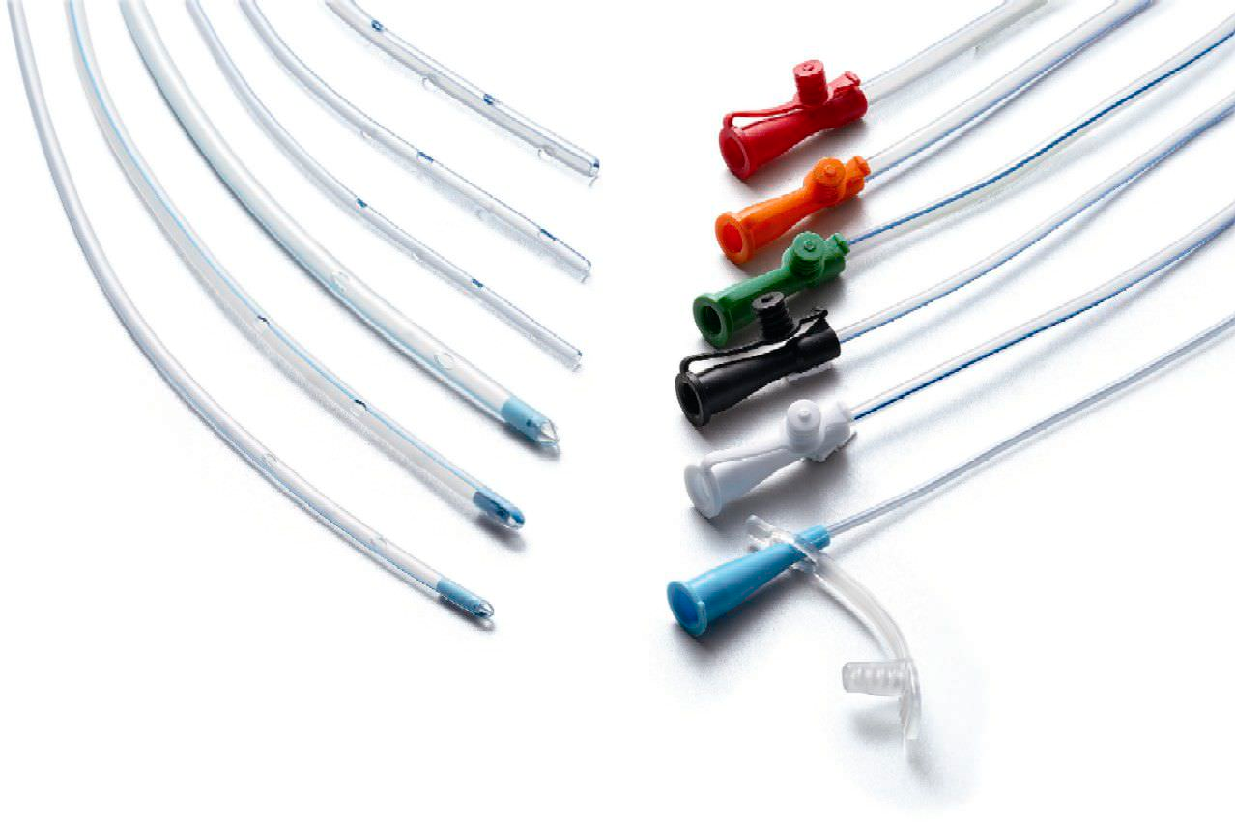
University of Basrah –College of Nursing– Fundamentals of Nursing Department
4

Slide 5
Intubating the client with an NG tube
Assessment
Who needs an NGT
Surgical patients.
Ventilated patients.
Neuromuscular impairment.
Patients who are unable to maintain adequate oral intake to meet metabolic/ nutritional demands.
To assess patency of the nares.
University of Basrah –College of Nursing– Fundamentals of Nursing Department
5

Slide 6
Assess patient’s medical history:
Nose bleeds.
Nasal surgery.
Deviated nasal septum.
Anticoagulation therapy.
GI history.
Conduct a thorough physical examination.
Assess patients gag reflex.
Assess patients mental status.
University of Basrah –College of Nursing– Fundamentals of Nursing Department
6

Slide 7
Technique
Equipment:
Non sterile disposable gloves.
Nasogastric (NG) tube—usually single-lumen Levin or double-lumen Salem sump tube.
Lubricant jelly.
PH test strips.
Tongue blade.
Flash light.
Emesis basin.
Syringes.
1 inch wide tape or commercial fixation device.
Collecting bag
Stethoscope.
University of Basrah –College of Nursing– Fundamentals of Nursing Department
7

Slide 8
Explain procedure to patient and relatives.
Position the patient in a setting or high Fowler’s position . If comatosed , semi- Fowler’s.
Examine feeding tube for flaw.
Determine the length of tube to be inserted.
Measure the distance from the tip of the nose to the earlobe and to the xyphoid process of the sternum.
Prepare NG tube for insertion.
University of Basrah –College of Nursing– Fundamentals of Nursing Department
8

Slide 9
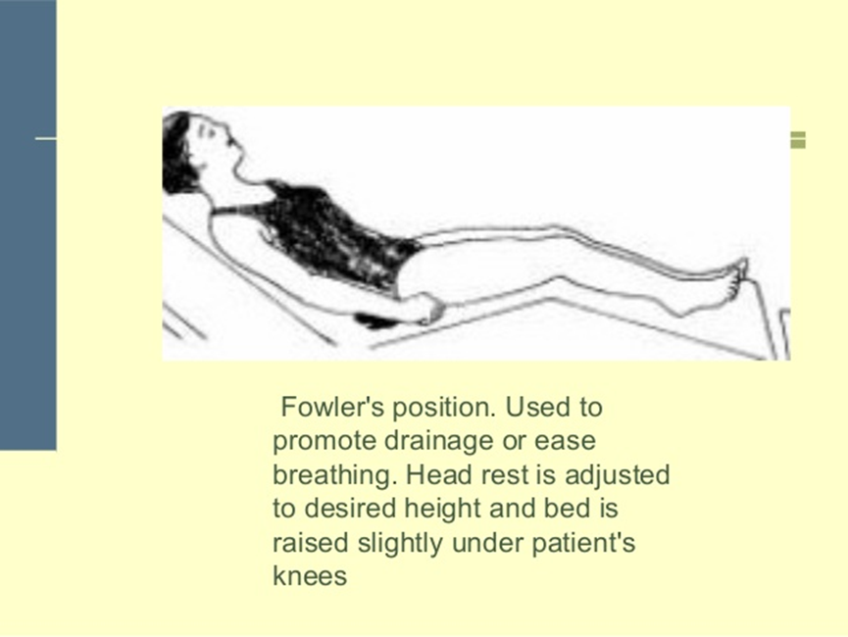
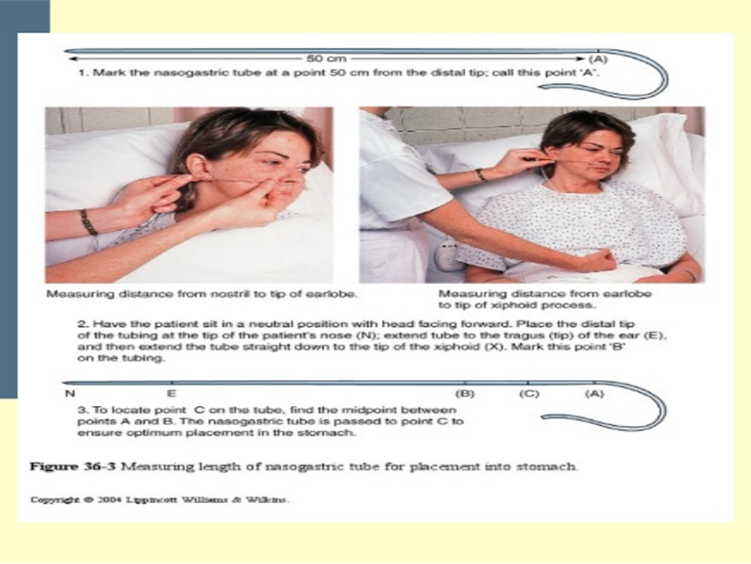
University of Basrah –College of Nursing– Fundamentals of Nursing Department
9

Slide 10
Implementation
Wash hands.
Apply clean gloves.
Lubricate the tube.
Hand the patient a glass of water.
Gently insert tube through nostril to back of throat (posterior naso pharynx).
Have the patient flex the head towards the chest after tube has passed through nasopharynx.
6. Emphasize the need to mouth breathe and swallow during the procedure.
7. Swallowing facilities the passage of the tube through the orophyrnx.
8. When the tip of the tube reaches the carina stop and listen for air exchange from the distal end of the tube . If air is heard remove the tube.
University of Basrah –College of Nursing– Fundamentals of Nursing Department
10

Slide 11
9. Advance tube each time patient swallows until desired length has been reached.
10.Do not force tube . If resistance is met or patient starts to cough , choke or become cyanotic stop advancing the tube and pull back.
11. Check the placement of the tube :
X- ray confirmation.
Testing PH of aspirate.
12. Secure the tube with tape or commercial device.
University of Basrah –College of Nursing– Fundamentals of Nursing Department
11

Slide 12
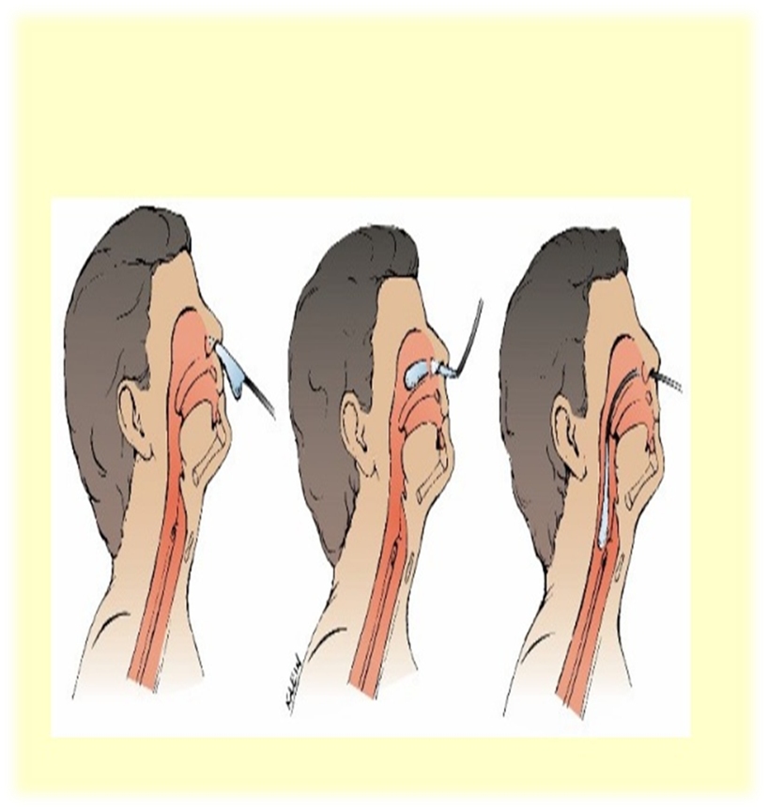
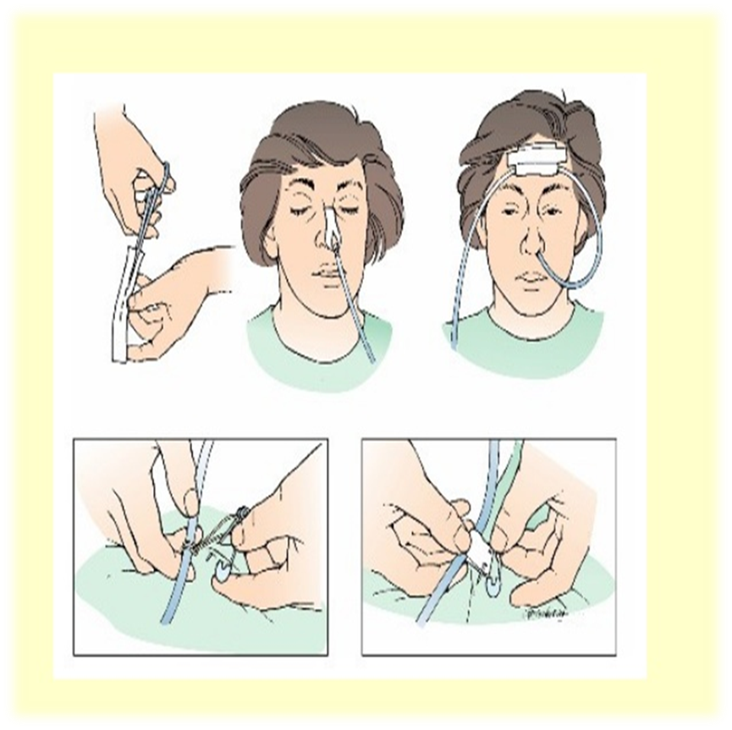

Slide 13
13. To check whether the tube is in the stomach:
a. Ask the patient to talk.
b. Use the tongue blade and penlight to examine the patient’s mouth—especially an unconscious patient.
c. Attach a syringe to the end of the NG tube. Place a stethoscope over the left upper quadrant of the abdomen, and inject 10 to 20 cc of air while auscultating the abdomen.
d. Obtain aspirate with 30- to 60-mL syringe. If stomach contents cannot be aspirated, reposition the patient and repeat air insufflation. Attempt to aspirate again.
e. X-rays may be done to confirm tube placement.
University of Basrah –College of Nursing– Fundamentals of Nursing Department
13

Slide 14
Nursing care
Encourage good mouth care and cleansing the nares routinely.
Coat patient’s lips with petroleum jelly.
Regularly check the tape that secures the tube.
Change the tape position daily and examine the tissue around the nose and under the tape.
Keep the head of the bed elevated 30 degrees at all times.
The feeding bag and tubing should be changed usually every 24 hours to prevent bacterial contamination.
Inspect gastric drainage.

Slide 15
Nasogastric Tube Removal
Equipment
Towel
Disposable gloves
Lip pomade
Mouth hygiene materials
Procedure:
1. Place a towel across the patient’s chest, and inform him that the tube is to be withdrawn.
2. Apply disposable gloves.
3. Turn off suction; disconnect and clamp tube.
4. Remove the tape from the patient’s nose.

Slide 16
5. Instruct the patient to take a deep breath and hold it.
6. Slowly, but evenly, withdraw tubing and cover it with a
towel as it emerges. (As the tube reaches the nasopharynx, you can pull quickly.)
7. Provide the patient with materials for oral care and lubricant for nasal dryness.
8. Dispose of equipment in appropriate receptacle.
9. Document time of tube removal and the patient’s reaction.
10.Document tube removal and color, consistency, and amount of drainage in suction canister.
11.Continue to monitor the patient for signs of GI difficulties

Slide 17
Enteral Nutrition
The administration of nutrients directly into the GI tract.
Nasogastric feeding is the most common route.
Nurses are the main health care professional responsible for intubation.
Administering Enteral Feeds:
Indications :
Patients who are unable to maintain adequate oral intake to meet metabolic demands.
Surgical cases.
Ventilated patient.
Neuromuscular impairment.
University of Basrah –College of Nursing– Fundamentals of Nursing Department
17

Slide 18
Contraindication
Patients with diffuse peritonitis.
Sever pancreatitis.
Intestinal obstruction.
Paralytic ileus.
University of Basrah –College of Nursing– Fundamentals of Nursing Department
18

Slide 19
Complications
Blocked tube most common.
Dumping syndrome.
Aspiration.
Dehydration .
Electrolyte imbalance .
Oral mucosal break down.
Nasal irritation.
University of Basrah –College of Nursing– Fundamentals of Nursing Department
19

Slide 20
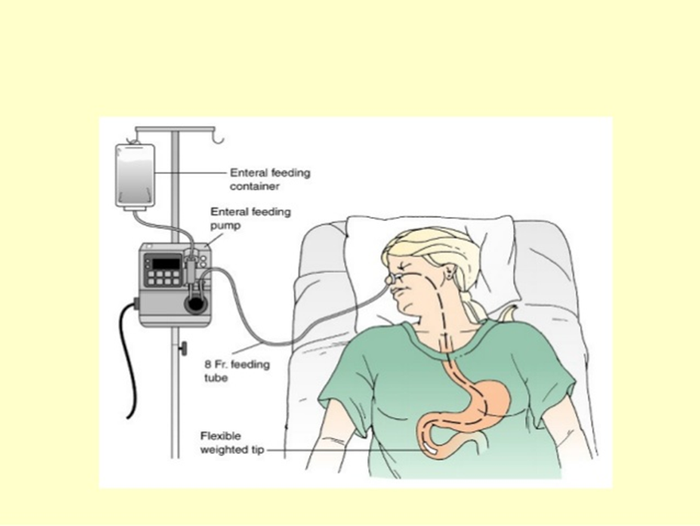
University of Basrah –College of Nursing– Fundamentals of Nursing Department
20

Slide 21
University of Basrah –College of Nursing– Fundamentals of Nursing Department
21

